Slide 1
Public support to organic vocational training and academic programs

Slide 2
Political justification for supporting organic vocational training and academic programs

Slide 3
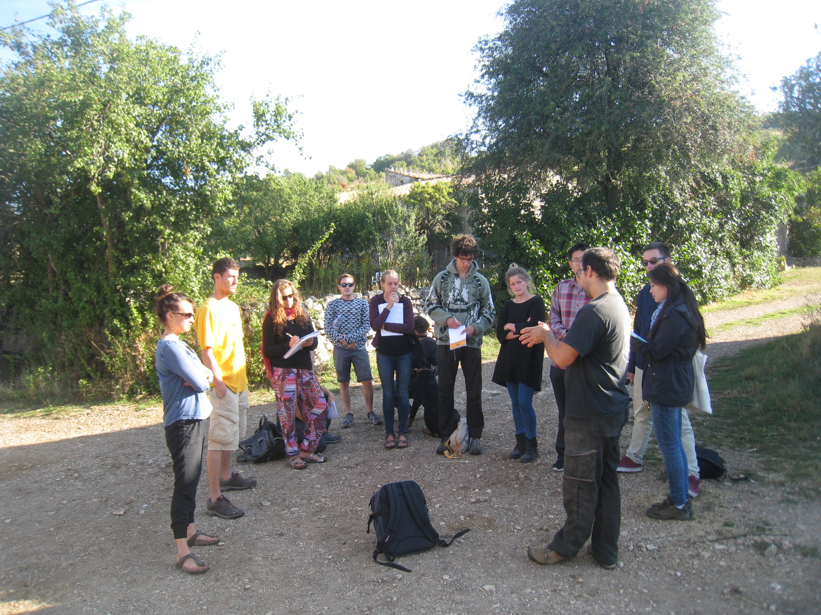
Building national organic knowledge
Organic Agriculture (OA) is knowledge-intensive.
Past decades of agricultural education have focused on conventional methods.
Need to develop organic agronomy and animal husbandry knowledge to accompany sector growth.
Organic knowledge also benefits conventional farmers who seek to increase sustainability.

Slide 4
Possible ways to support organic vocational training and academic programs

Slide 5
Supporting organic education
Ideal scenario: mainstream OA through compulsory courses in all agricultural education programs + offer specialized OA diplomas & degrees.
Special OA department within existing universities ensure stable pool of OA experts.
Offer whole OA MSc degrees and diploma degrees OR offer some optional OA specialization in regular agricultural degrees.
Cooperation between various universities to offer a degree program in OA (e.g. in the EU, there are 2 such programs).
Provide funding/grants to organic vocational training programs run by NGOs. Finance OA training for people who are already agricultural professionals (e.g. staff of extension service, university lecturers).
Fund projects to develop OA curriculum.

Slide 6
Country examples

Slide 7
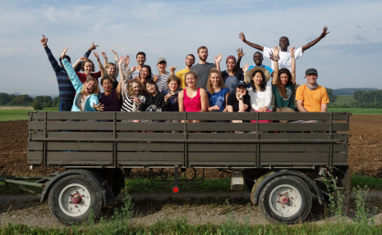
Switzerland
All agricultural schools offer a course on OA since 1996.
Nowadays, a 2-day course on Organic Farming is mandatory for every agricultural student/apprentice and optional OA specializations are always available.
1 specialized OA vocational school for (future) organic famers.
Concept for OA education always in further development (lead by FiBL and Biosuisse).

Slide 8
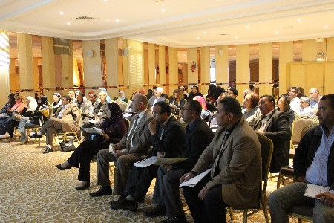
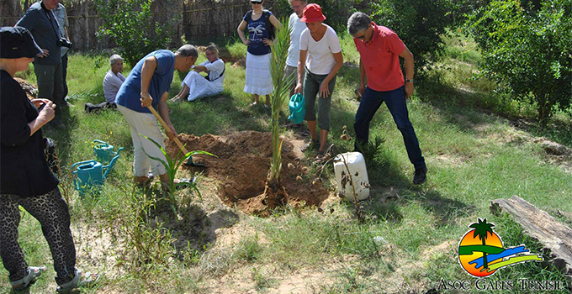
Tunisia
Compulsory OA courses at all higher agronomic institutes.
MSc degree programs in Sustainable & Organic Agriculture offered in several higher institutions (combine education & research purposes).
A diploma program in OA jointly conducted by the Agricultural Investment Promotion Agency and AVFA, the Agriculture Training and Extension Agency.
Notes:
Tunisia is the leader country in Africa when it comes to organic production and exports. For more than a decade, the Tunisian government has promoted organic agriculture development through a comprehensive set of measures, such as the inclusion of organic options in agricultural education programs.

Slide 9
Pitfalls and challenges of this form of support

Slide 10
Main challenges
Lack of initial qualified organic teachers at the start is a bottleneck. Few people that have studied OA abroad.
Policy makers can make top-down decisions that agricultural universities should switch to more pro-organic curriculum. However can face resistance from the university staff if those have taught conventional agriculture their whole life (e.g. Kerala). Change may take a generation time.
Vocational training must meet the needs of the farmers (needs assessment recommended).
Large-scale vocational training programs may lack sufficient qualified organic trainers. Need to start with a ToT phase.
Notes:
ToT: Training of trainers.

Slide 11
Thank you for your attention!
Complete policy toolkit available at www.ifoam.bio

